Slide 1

CS-250 Project 3
By William Leaver

Slide 2
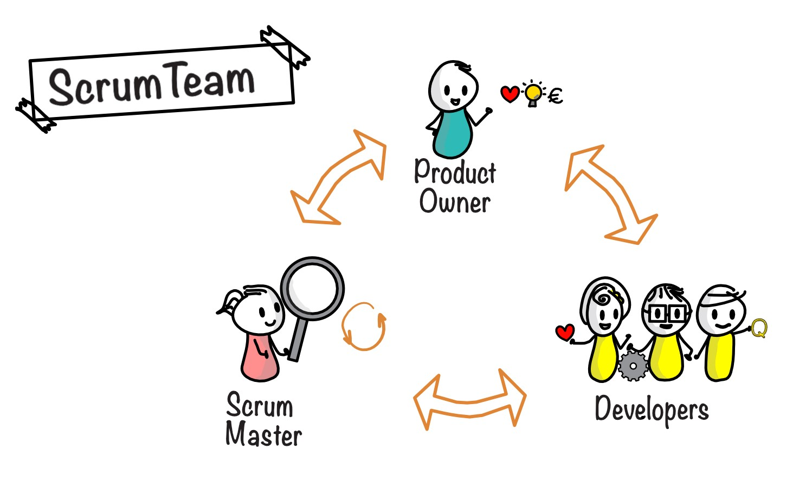
Agile Roles
Scrum Master
oversee running daily Scrum meetings
ensuring everyone is on track with the agile process in place
assisting in overcoming any hindrances that are brought to light during meetings
sprint reviews
Product Owner
They handle customer/client contact
Develop user stories
Work with the development team on estimations of task length
Developers/Testers
handle developing test cases from user stories
testing products to ensure they will be ready for the end of a sprint.

Slide 3
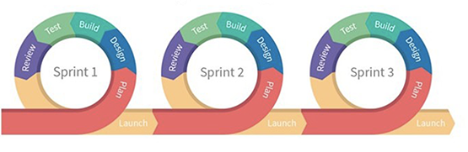
Agile Phases
Works in sprints
More flexible
Finished product always ready

Slide 4

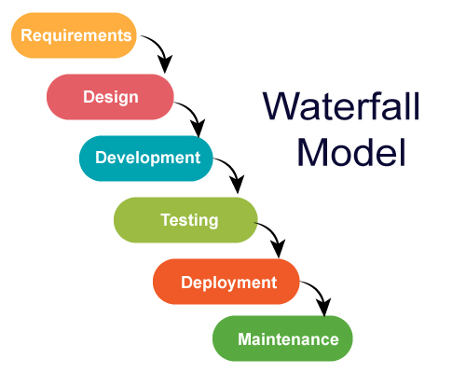
Waterfall Model
Less flexibility
Finished product is not tested until close to deployment
Longer planning stage

Slide 5
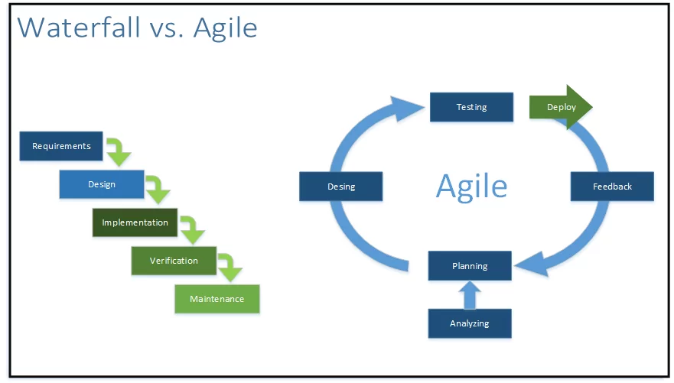
Waterfall or Agile
In conclusion, Agile is superior to Waterfall
Better Flexibility
Fewer bugs
Always have a finished product
Less upfront planning
More client/user interaction

